Slide 1
SALES ANALYSIS
Business Performance Report
Amrutha V
November 2025

Slide 2
Business Requirements
Through This Power BI Analysis, we will:
Understand the business growth and challenges
Analyze sales and performance metrics across dimensions
Identify geographical areas with high and low sales
Support data-driven business decisions

Slide 3
Problem Statements (Part 1)
Total Sales Analysis: Understand overall sales performance.
Quantity Sold Analysis: Examine total units sold to gain insight into product demand.
Discount Impact: Evaluate discount patterns and their effect on sales.
Regional Performance: Analyze sales distribution across different regions
Product Category Analysis: Evaluate performance across product categories
Problem Statements (Part 2)

Slide 4
Analysis Done For (Part 1)
Product Performance Table: Detailed breakdown by product ID showing sales metrics
Monthly Sales Trend (Area Chart): Visualize sales patterns throughout the year
Discount by Category (Pie Chart): Distribution of discounts across product categories
Analysis Done For (Part 2)
Regional Performance (Bar Chart): Sales and quantity comparison across regions
KPI Cards: Display key metrics at a glance for quick insights

Slide 5
Overall Performance Metrics
Total Sales
5.02M
Sum of Sales Amount
Quantity Sold
25K
Total Units
152.39
Sum of Discounts

Slide 6
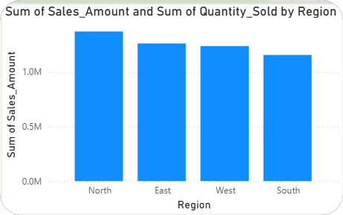
Regional Performance Analysis
North, East, West, and South regions analyzed.
Consistent performance across all four major regions.
Sales volume distributed relatively evenly geographically.
Regional strategies can be optimized based on patterns.

Slide 7
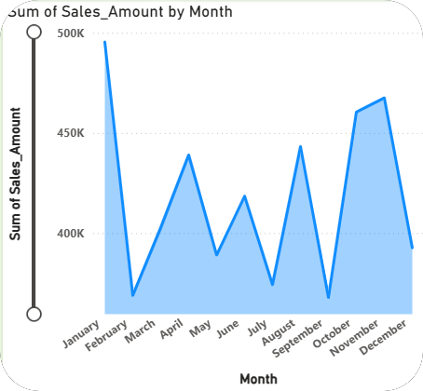
Key Insights - Sales Trends
Peak sales observed in specific months showing seasonal patterns
Monthly trend analysis reveals growth opportunities
Area chart visualization identifies high and low performance periods
Total sales of 5.02M achieved across all products

Slide 8
Key Insights - Product Categories
Four main categories: Clothing, Electronics, Food, and Furniture
Discount distribution varies significantly by category
Product-level performance tracked in detailed table view
Category-wise strategies can be refined for better margins

Slide 9
Conclusion & Key Findings
Comprehensive view of sales performance across all dimensions
Strong sales volume of 5.02M with 25K units sold
Regional balance provides stable business foundation
Data-driven insights enable strategic business planning

Slide 10
Thank You!

